Slide 1
DATA SCIENCE
Under the Esteemed Guidance of
DR.P. Sreedhar
Assoc.Professor,CSE Dept.
presented by
D.SASI KALA
Y20AIT425

Slide 2
Abstract
In this presentation, we break down how machines, through clever learning tricks, can help tackle hate speech online. We'll chat about how computers understand human language, spot negative vibes, and lend a helping hand in making the internet a friendlier place. Join us for a beginner-friendly exploration of how tech can be our ally in the fight against hate on the web
With the rise of social media people have the liberty to express themselves, many users misuse this liberty and we can see abuse and hate spread all across social media platforms, be it in the form of comments, blogs, etc. Machine Learning is widely used in various fields of research, we intend to use machine learning to automate the detection of hate speech.

Slide 3
EXISTED SYSTEM:
The presentation provides an overview of the existing systems in data science, focusing on the tools and frameworks that form the backbone of modern data analysis. We explore widely adopted technologies such as Python, R, and SQL, along with popular libraries like Pandas, NumPy, and scikit-learn.
By understanding these existing systems, we lay the foundation for comprehending the dynamic landscape of data science tools and their impact on extracting valuable insights from data.
PROPOSED SYSTEM:
We explore emerging technologies like machine learning frameworks (e.g., TensorFlow and PyTorch), cloud computing platforms (such as AWS and Azure), and data visualization tools (like Tableau and Power BI). The proposed system leverages the power of automation, artificial intelligence, and deep learning to enhance data analysis capabilities. Join us as we envision the future of data science, embracing cutting-edge tools that pave the way for more efficient, accurate, and scalable data-driven insights.

Slide 4
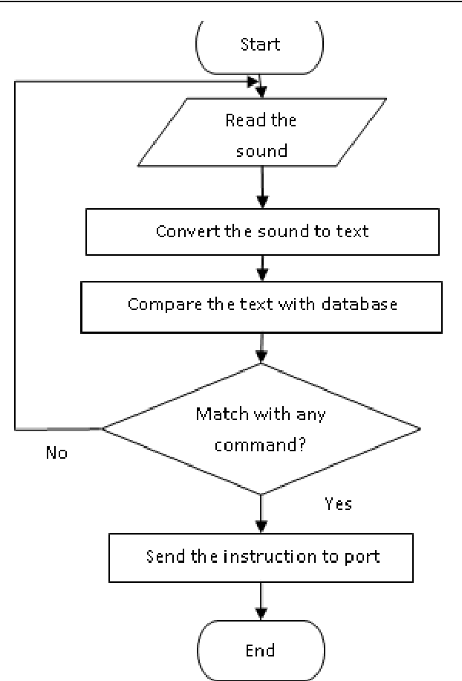
start
Flow chat for hate speech detection

Slide 5
1.Libraries :
numpy: Provides support for arrays and mathematical functions.
re: Regular expression operations for string manipulation.
string: Provides string-related operations.
nltk.corpus: Natural Language Toolkit library for language processing tasks.
nltk.stem: Snowball Stemmer for word stemming
sklearn.feature_extraction.text.CountVectorizer: Converts a collection of text documents to a matrix of token counts.
sklearn.model_selection.train_test_split: Splits data into training and testing sets.sklearn.tree.
DecisionTreeClassifier: Decision Tree classifier.sklearn.

Slide 6
2.Reading the dataset:
• Reads a CSV file containing Twitter data using 'pandas’.
3.Data preprocessing:
Maps the numeric class labels to descriptive labels.
Select only “tweet” and “labels” columns.
Define a set of English stopwords and a snowball stemmer.
4.Text Cleaning Function:
Converts text to lowercase.
Removes words containing digits .
Removes stopwatch.
5.Applying text cleaning to the dataset:
Applies the 'clean_data function to the "tweet" column of the dataset.
6.Feature Extraction using CountVectorizer:

Slide 7
7.Train-Test Split:
Splits the data into training and testing sets.
8.Decision Tree Classifier:
Initializes a Decision Tree classifier.
9.Model Training:
Fits the Decision Tree classifier on the training data.
10.Model Evaluation:
Predicts the labels on the test set.
Computes a confusion matrix using confusion_matrix.
Visualizes the confusion matrix using a heatmap.
11.Accuracy Calculation:
Calculates and prints the accuracy of the model using accuracy_score.
12.Sample Prediction:
Takes a sample text, cleans it using the clean_data function.
Converts the cleaned text into a feature vector using the previously fit CountVectorizer.

Slide 8
REFERENCE:
https://chat.openai.com/c/ff8b6fa0-17c8-42b1-aa8f-4cfb7572707c.
https://copyassignment.com/hate-speech-detection.
https://chat.openai.com/c/4353eeb2-476a-4c44-9381-27a34d5a2945.
https://1stop.ai/student-board.
https://www.geeksforgeeks.org/hate-speech-detection-using-deep-learning/.
https://youtu.be/RBSUwFGa6Fk?si=Jmy0qLr6vdaFnk-5 /
CONCLUSION:
In this article, we have built a project for Hate Speech detection using Machine Learning. Hate speech is one of the serious issues we see on social media platforms like Facebook and Twitter. Hope you enjoyed this article by building a project to detect hate speech with Python.

Slide 9
THANK YOU

